Slide 1
Project: FRUIT APP
Team 03
SYntax error
Members:
Carlos granda
Ronny Ibarra
Jose imbaquinga

Slide 2
WHAT IS THE PROBLEM?
We need an application that helps us determine the best way to distribute and control the products that are sold and brought to sell, depending on the user that you just want to perform. Since it is very difficult to control all this by a single person and without having a program in which to enter the data. By using the app, the user can update some values ​​of the products in their price and also that the user can update the products that were sold and those that were entered at the greengrocer for sale,Also, if you have workers, you can record the data to see the days in which you went to help in the sale of products and thus count the days worked and pay your monthly payment. In itself, we would need an inventory which helps us store all the data on fruits and vegetables, such as how many products enter, how many products are sold and at what price they are sold.

Slide 3
REQUERIMENTS OF OUR SYSTEM
The system shall inform the user how much each product they buy costs
The system shall indicate how many products are left to be sold
The system shall save information of the money that has entered for the sale
The system shall indicate the prices of each product found in the store.

Slide 4
OVERVIEW
The app will help customers check out the products they want to buy, making queues faster and more agile, thus avoiding any type of extremely long queue. This will be implemented through the barcode of each product that the customer will scan with his cell phone through an app through the camera, and with all the desired products the app will have options of different payment methods, these would be payment with card or with cash payment since with this the purchases will be speeded up, long lines will be avoided, thus saving a lot of waiting time in these. Apart from speeding up queues, this app will have notifications of new products, discounts and coupons, as well as a map or indications of where the product is to help the customer and thus save time

Slide 5
BACKGROUND
What is an inventory?
The inventory is the simplest document in accounting and consists of a detailed, ordered and valued list of all assets, rights and debts of a company.In the past, inventories were carried out by physical means (on paper) but now, the most common thing is that they are kept centrally in databases.Thanks to the inventory, possible errors recorded in the entry and exit records can be corrected. The three main functions of inventory are:It is the basis of the annual accounts.It is used to detect possible losses due to theft, shrinkage, etc.With it you can correct possible errors recorded in the inventory accounting.

Slide 6
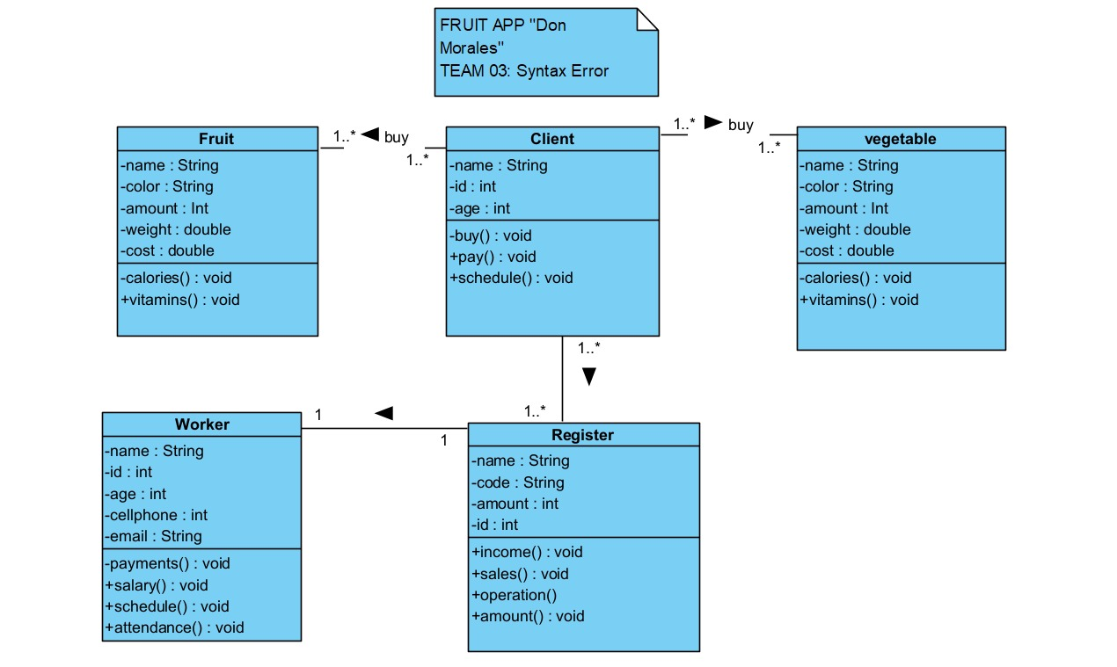

Slide 7
